Slide 1
Unit Testing
Phong Võ - Bluecat Team

Slide 2
Table of contents
What’s Unit Testing
Why Unit Testing
Mock
Settup Project Unit Testing
How Unit Testing
Coverage
Best Practice
Write Unit Test Together In Real Project

Slide 3

What’s Unit Testing
Examine each unit of your code separately (methods, classes …)
Design software components
Unit test is not about finding bugs
Notes:
A unit is the smallest testable part of any software
a unit may be an individual program, function, procedure, etc. In object-oriented programming, the smallest unit is a method, which may belong to a base/ super class, abstract class or derived/ child class
Note: there’s one exception where unit tests do effectively detect bugs. It’s when you’re refactoring, i.e., restructuring a unit’s code but without meaning to change its behaviour. In this case, unit tests can often tell you if the unit’s behaviour has changed.
It is performed by using the White Box Testing method.

Slide 4
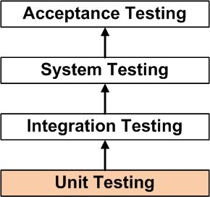
What’s Unit Testing
Notes:
A unit is the smallest testable part of any software
a unit may be an individual program, function, procedure, etc. In object-oriented programming, the smallest unit is a method, which may belong to a base/ super class, abstract class or derived/ child class
Note: there’s one exception where unit tests do effectively detect bugs. It’s when you’re refactoring, i.e., restructuring a unit’s code but without meaning to change its behaviour. In this case, unit tests can often tell you if the unit’s behaviour has changed.
It is performed by using the White Box Testing method.
Who performs it?
It is normally performed by software developers themselves or their peers. In rare cases, it may also be performed by independent software testers.

Slide 5
Why Unit Testing
Unit testing increases confidence in changing/ maintaining code
Codes are more reusable
Development is faster
The cost of fixing a defect is less
Debugging is easy.
Codes are more reliable.
Document details of the project
Notes:
Note: there’s one exception where unit tests do effectively detect bugs. It’s when you’re refactoring, i.e., restructuring a unit’s code but without meaning to change its behaviour. In this case, unit tests can often tell you if the unit’s behaviour has changed.
Well then, if unit testing isn’t about finding bugs, what is it about?
I bet you’ve heard the answer a hundred times already, but since the testing misconception stubbornly hangs on in developers’ minds, I’ll repeat the principle. As TDD gurus keep saying, “TDD is a design process, not a testing process”. Let me elaborate: TDD is a robust way of designing software components (“units”) interactively so that their behaviour is specified through unit tests. That’s all!
Development is faster
The effort required to find and fix defects found during unit testing is very less in comparison to the effort required to fix defects found during system testing or acceptance testing.

Slide 6

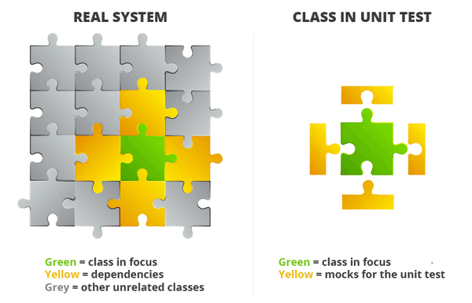
Mock
Notes:
Mock is a fake object, function, variable, class ..v..v.
If you look up the noun mock in the dictionary you will find that one of the definitions of the word is something made as an imitation
Mocking is primarily used in unit testing. An object under test may have dependencies on other (complex) objects. To isolate the behavior of the object you want to replace the other objects by mocks that simulate the behavior of the real objects. This is useful if the real objects are impractical to incorporate into the unit test.

Slide 7
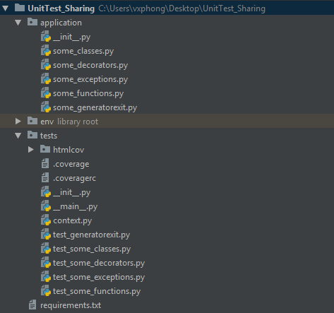
Setup Project Unit Testing
Link: https://github.com/PhongVX/Unitest-Sharing.git

Slide 8
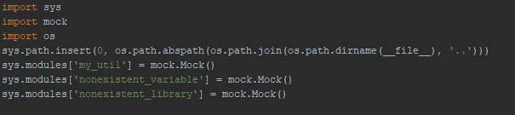
Setup Project Unit Testing
Context.py
Correct absolute path
Mock the importing library that nonexistent in the application

Slide 9

Setup Project Unit Testing
To run multiple test file run file __main__.py

Slide 10
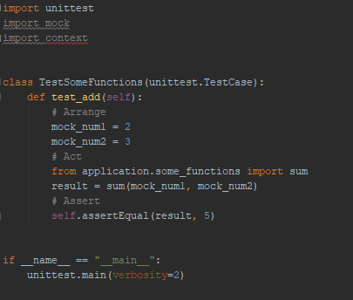
How Unit Testing
Simple structure of the test file
Import
Create Testing Class
Create Testing Function
Arrange
Action
Assert
Run

Slide 11

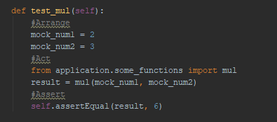
How Unit Testing
Simple function Testing For Simple function

Slide 12

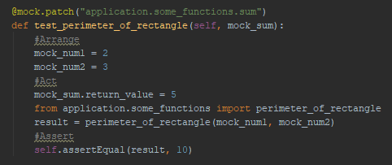
How Unit Testing
Function call the orther function Testing Function call the orther function

Slide 13
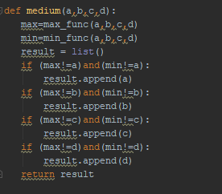
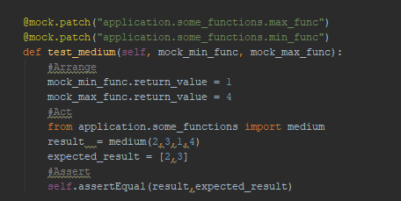
How Unit Testing
Function call some orther functions Testing Function call some orther functions

Slide 14

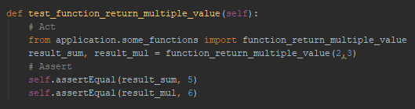
How Unit Testing
Function return multiple values Testing Function return multiple values

Slide 15
How Unit Testing
Function return multiple values Testing Function return multiple values

Slide 16
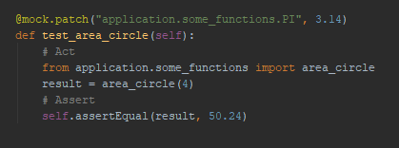
How Unit Testing
Function with nonexistent variable Testing Function with nonexistent variable

Slide 17
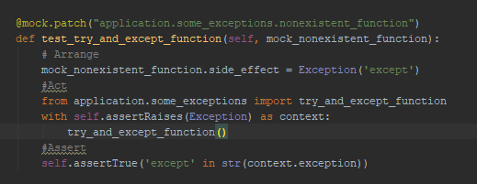
How Unit Testing
Function Raising Exception Testing Function Raising exception

Slide 18
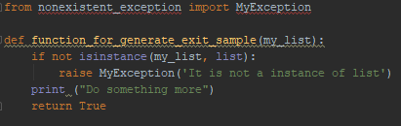
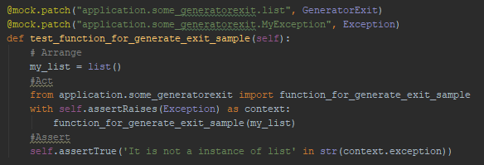
How Unit Testing
Function Generator Exit Testing Function Using Generator Exit

Slide 19
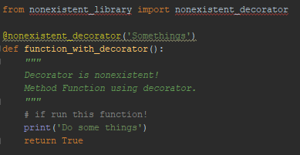
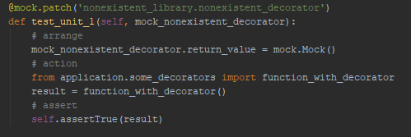
How Unit Testing
Function With Decorator Testing Function With Decorator

Slide 20
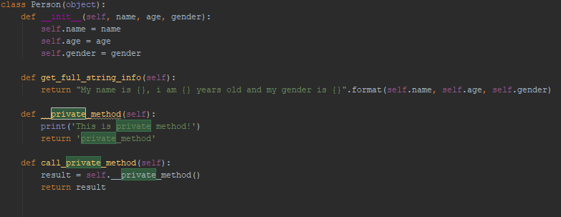
How Unit Testing
Class Person

Slide 21
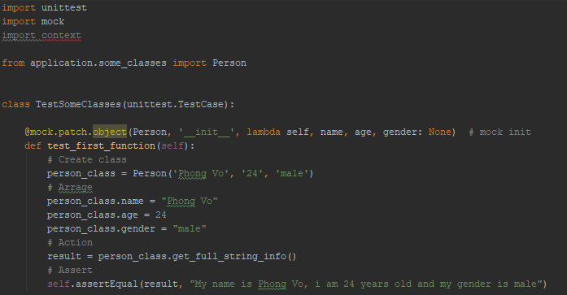
How Unit Testing
Testing Class
Import class
Bypass __init__
Arrage
Action
Assert

Slide 22
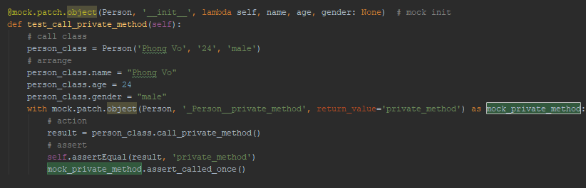
How Unit Testing
Call Private Method In Class

Slide 23
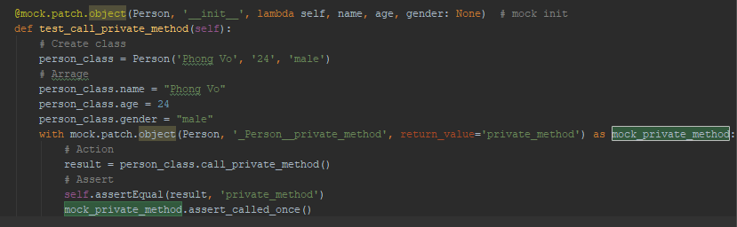
How Unit Testing
Testing Call Private Method

Slide 24
How Unit Testing
There are so many assert functions you can try by your self
assertTrue
assertEqual
assert_called_once
assert_called_once_with
….

Slide 25
Coverage
What’s and Why code coverage
Measuring source code has been tested
Using for code coverage report
Measure the efficency of test implementation

Slide 26
Coverage
Code coverage methods
Statement Coverage
Condition Coverage
Branch Coverage
Toggle Coverage
FSM Coverage

Slide 27

Coverage
Statement Coverage

Slide 28
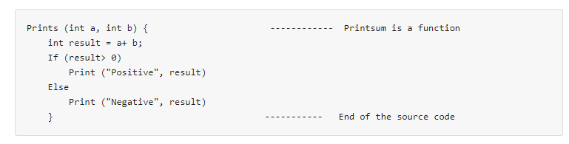
Coverage
Example Statement Coverage:

Slide 29
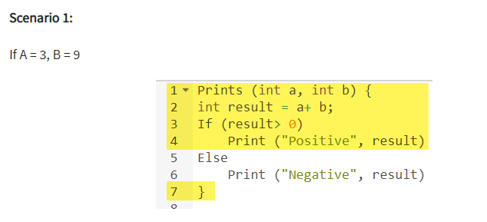
Coverage
Number of executed statements = 5
Total number of statements = 7
Statement Coverage: 5/7 = 71%

Slide 30
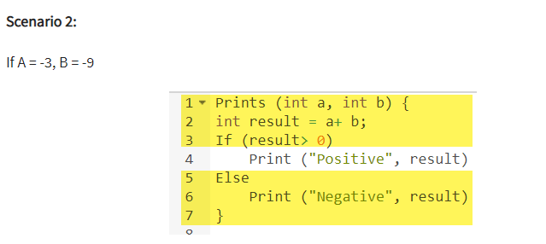
Coverage
Number of executed statements = 6
Total number of statements = 7
Statement Coverage: 6/7 = 85%

Slide 31
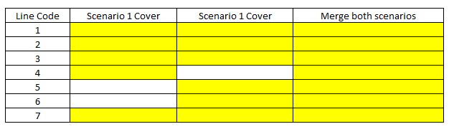
Coverage
Total

Slide 32

Coverage
Condition Coverage

Slide 33
Coverage
Branch Coverage

Slide 34
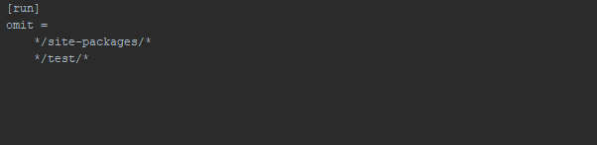
Coverage
.coveragerc
Exclude all the file in the packages that don’t need to report

Slide 35
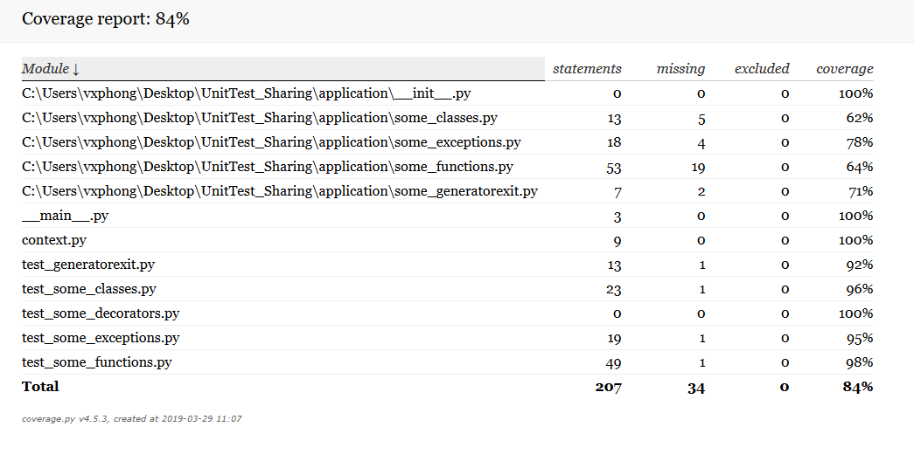
Coverage
Run coverage
Coverage run __main__.py
Coverage report
Coverage html

Slide 36
Best practice
Arrange, Act, Assert
One Assert Per Test Method
Avoid Test Interdependence
Keep It Short, Sweet, and Visible
Recognize Test Setup Pain as a Smell
Add Them to the Build
Notes:
https://stackify.com/unit-testing-basics-best-practices/

Slide 37
Write Unit Test Together In Real Project
Notes:
https://stackify.com/unit-testing-basics-best-practices/

Slide 38
References
http://softwaretestingfundamentals.com/unit-testing/
https://stackify.com/unit-testing-basics-best-practices/
https://www.guru99.com/unit-testing-guide.html
http://blog.stevensanderson.com/2009/08/24/writing-great-unit-tests-best-and-worst-practises/
https://www.guru99.com/code-coverage.html

Slide 39

Thanks For Listening

